Slide 1
Adham Ashraf Saeed
Assignment 1_Part 1 & 2 (Python)

Slide 2
GitHub link for the task
Assignment1

Slide 3
Part 1
Ask the user to enter daily sales amounts until a negative number is entered.
Store all valid sales values in a list.
Create a dictionary where the key is the day number and the value is the sale amount.
Calculate total sales, average sales, maximum and minimum sale.
Create separate functions for each calculation.
Add validation to handle non-numeric inputs gracefully.

Slide 4
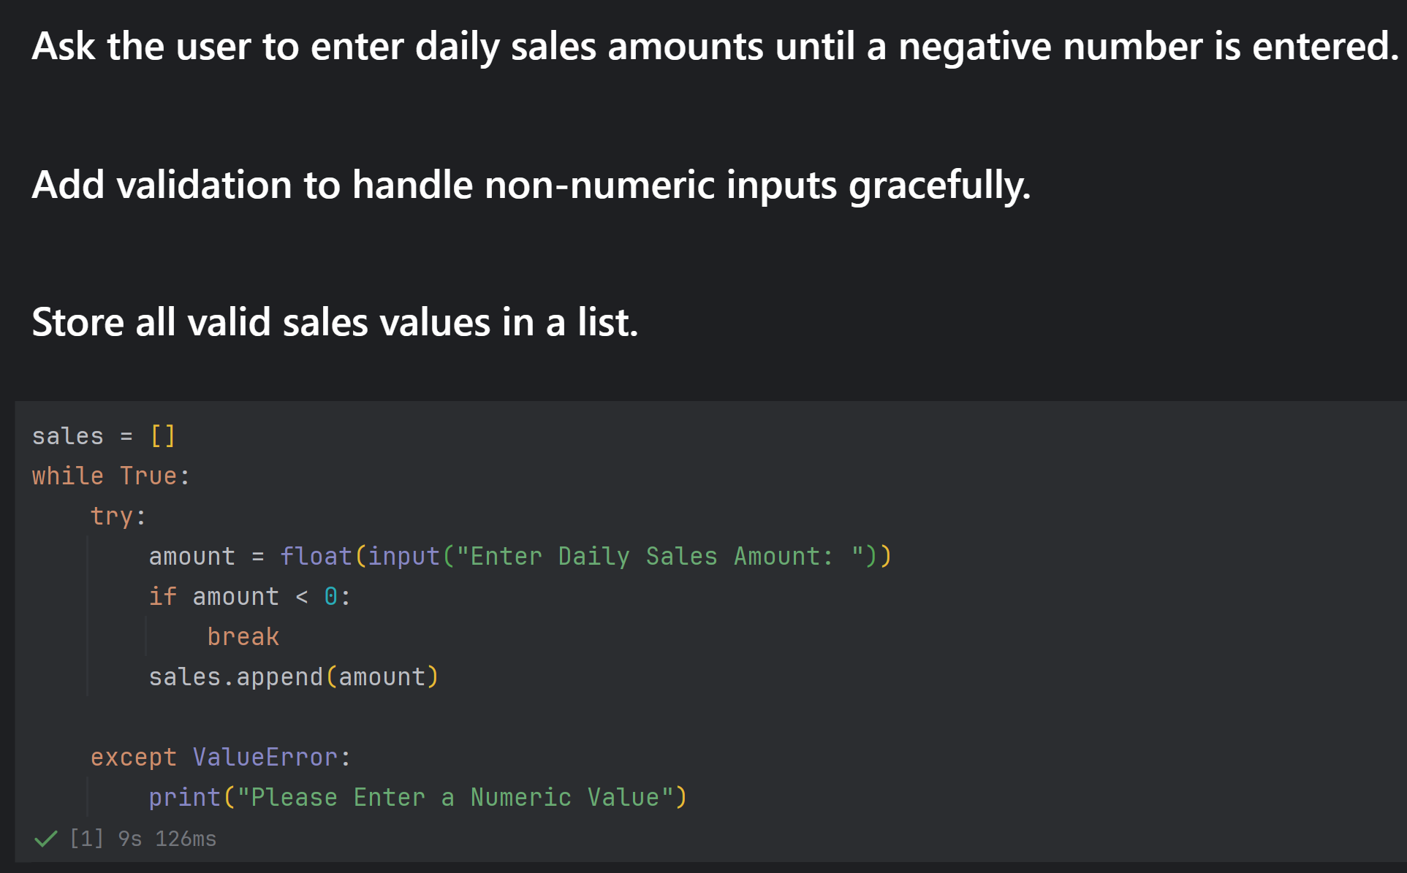
Part 1

Slide 5
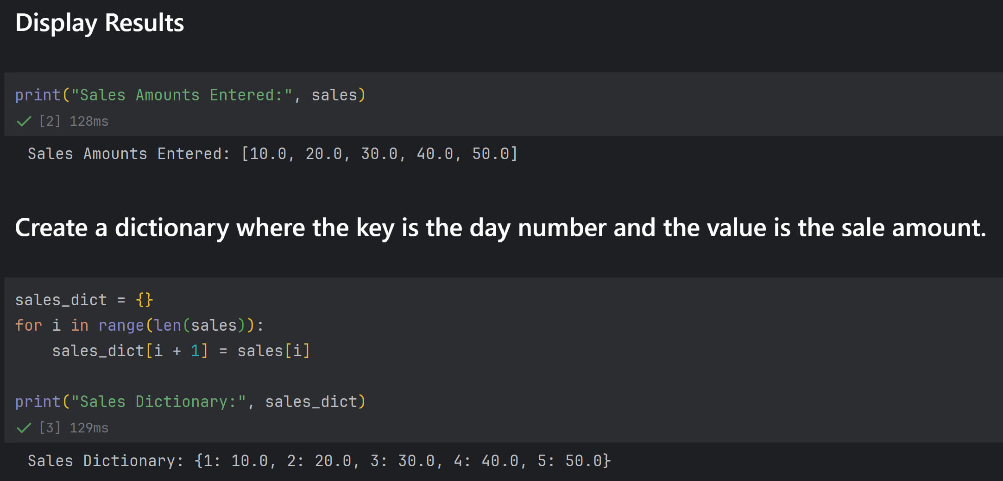
Part 1

Slide 6
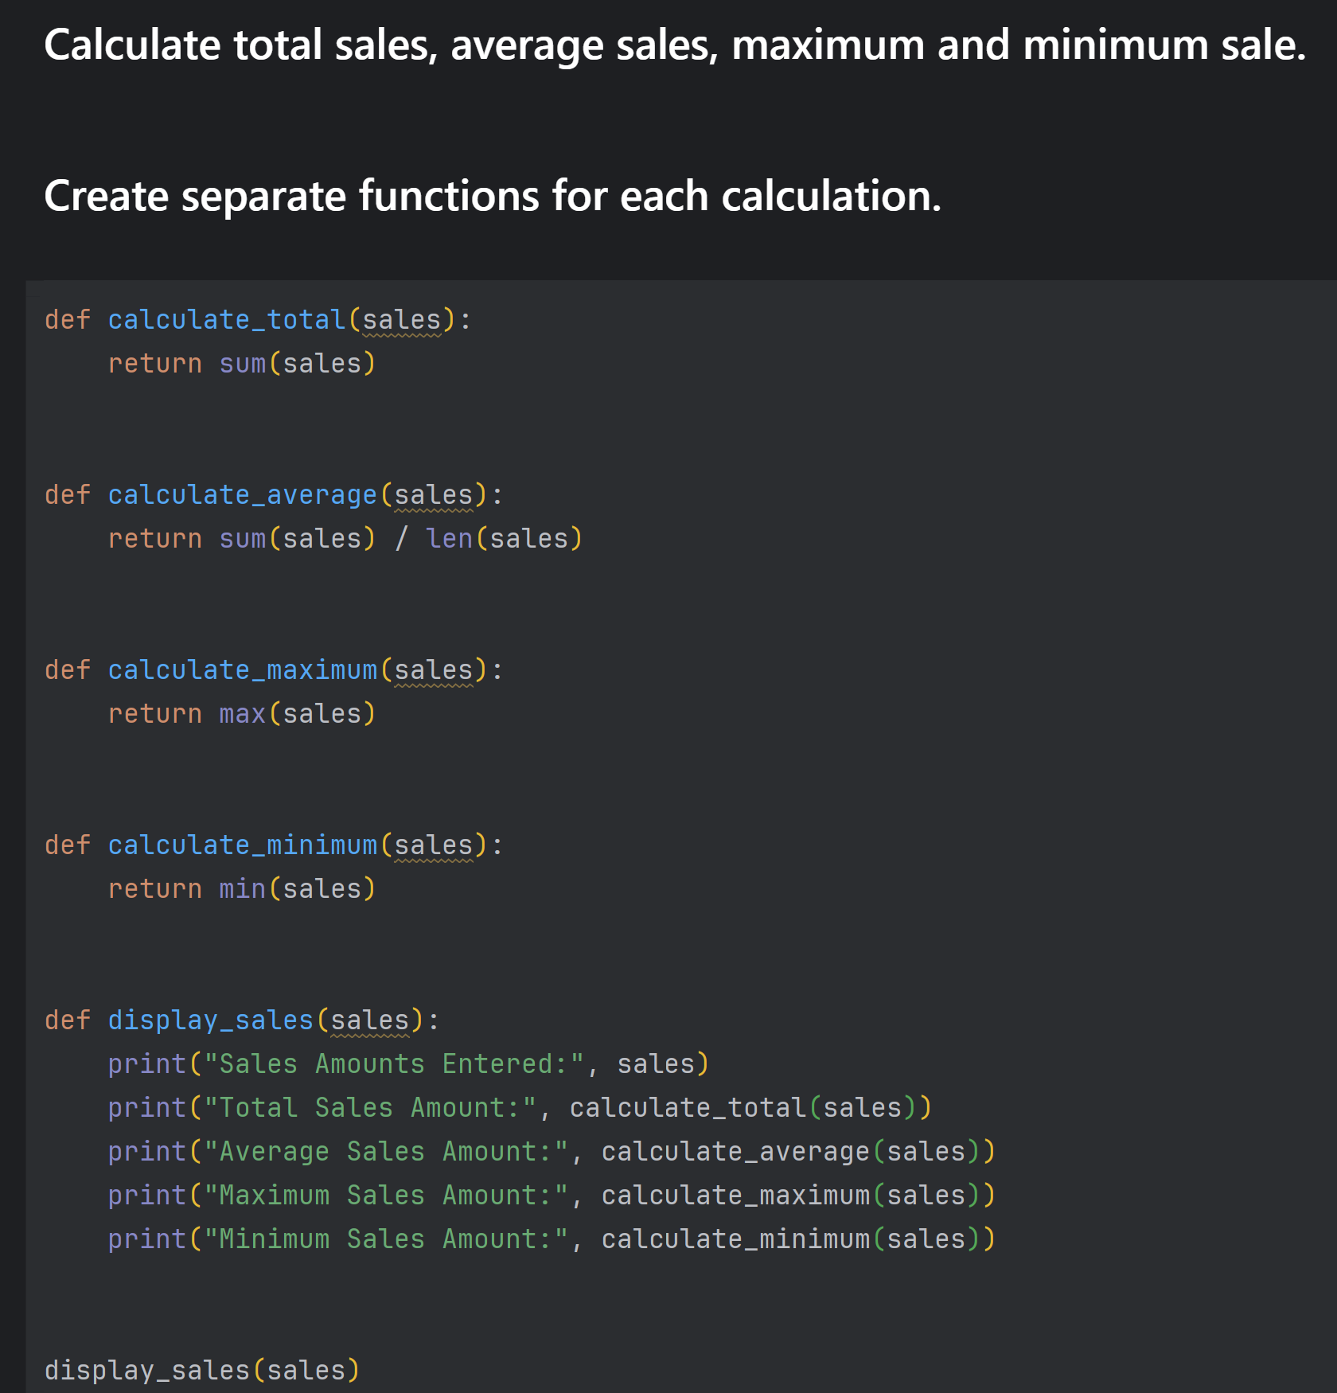
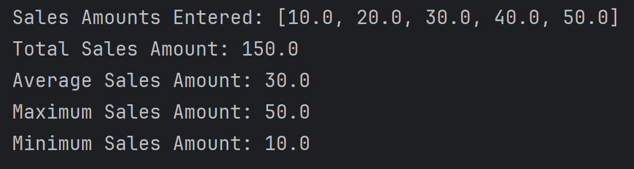
Part 1

Slide 7
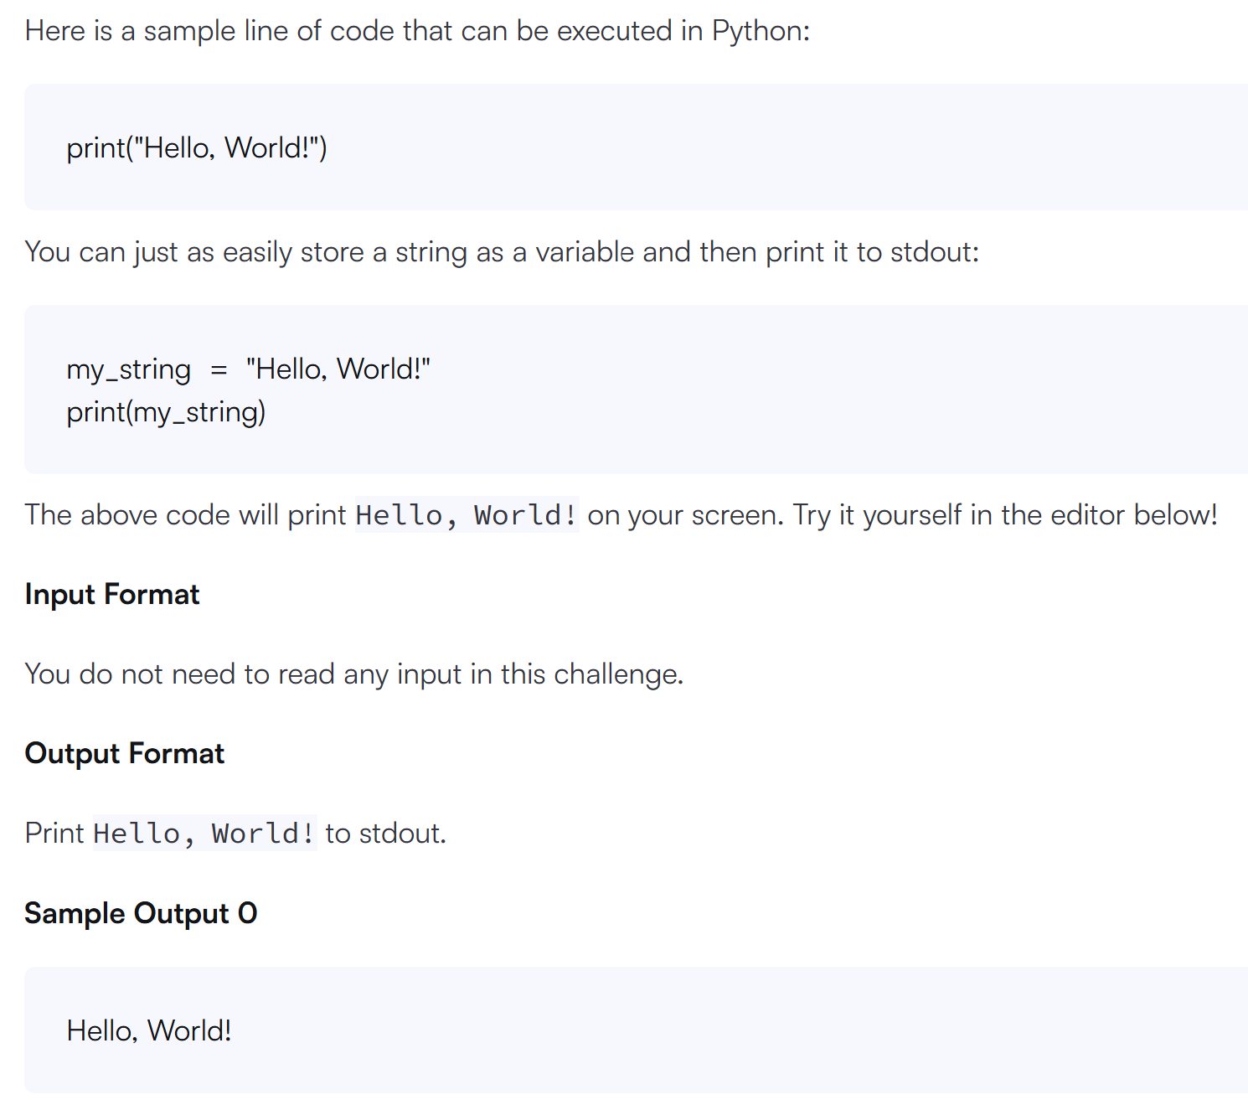
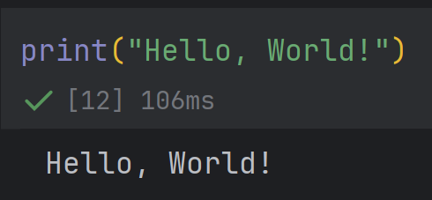
Part 2

Slide 8
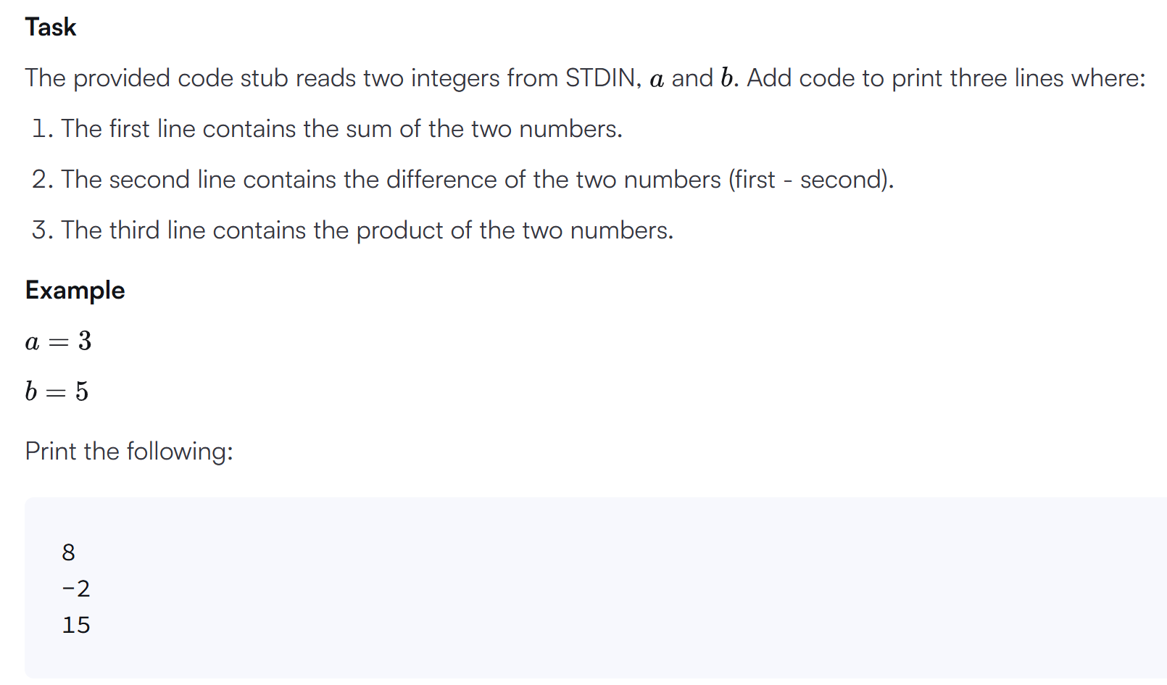
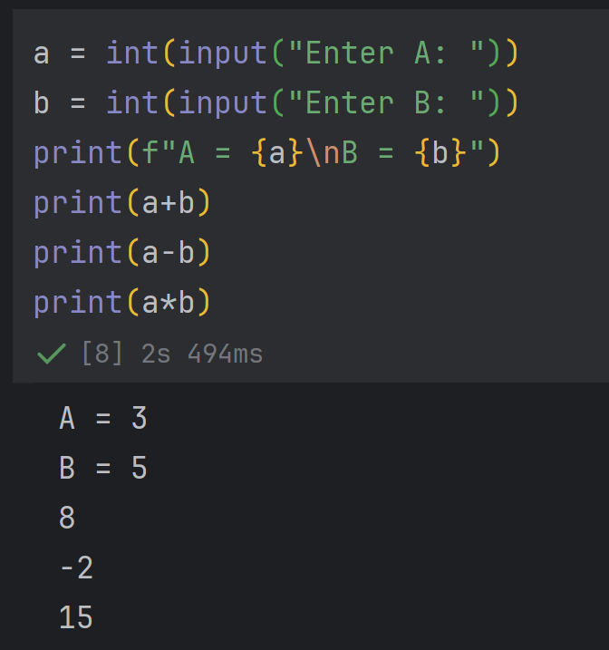
Part 2

Slide 9
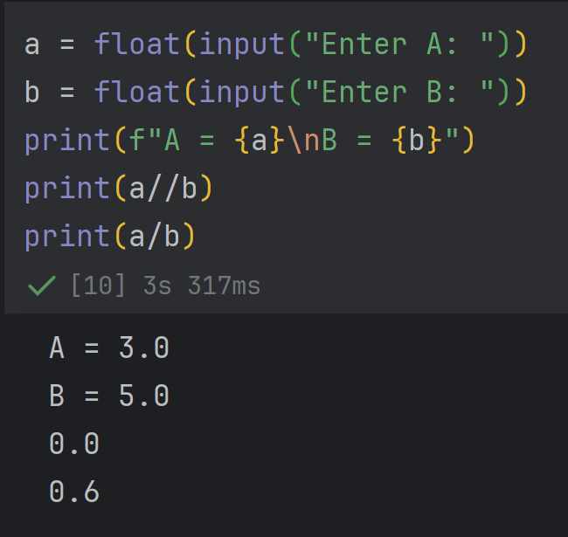
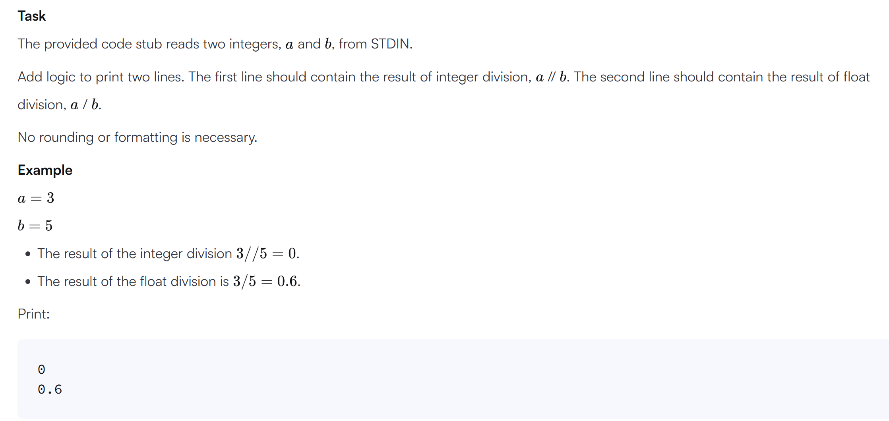
Part 2

Slide 10
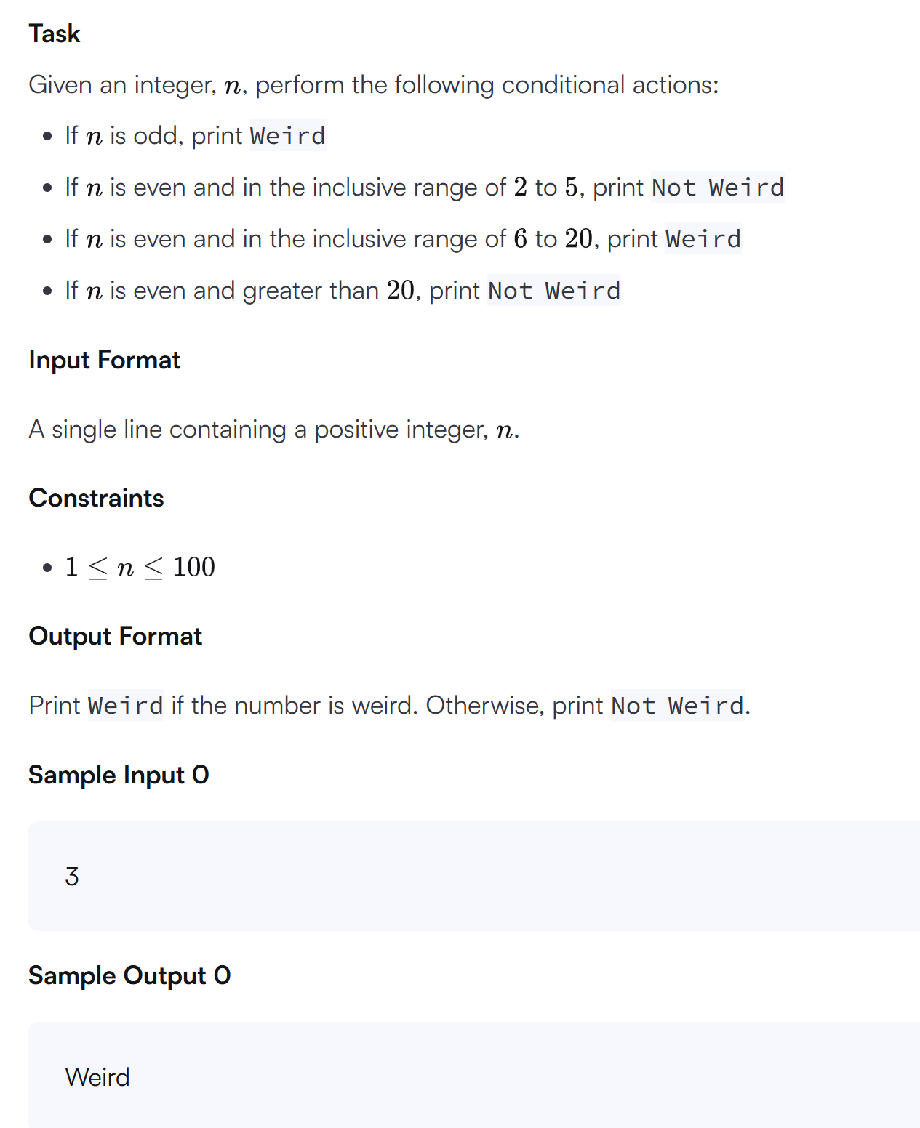
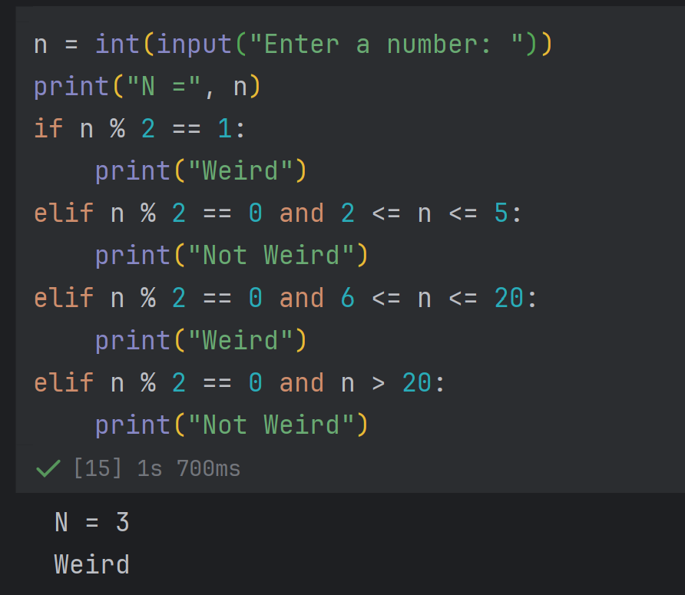
Part 2

Slide 11
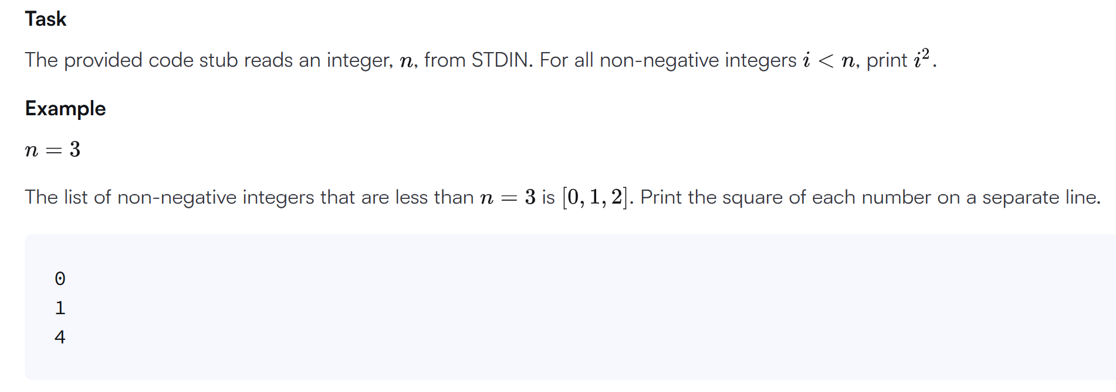
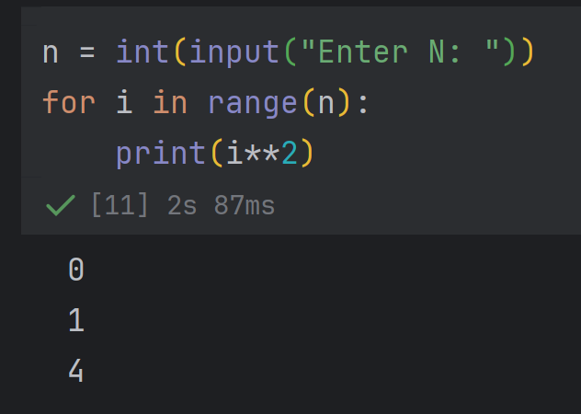
Part 2

Slide 12
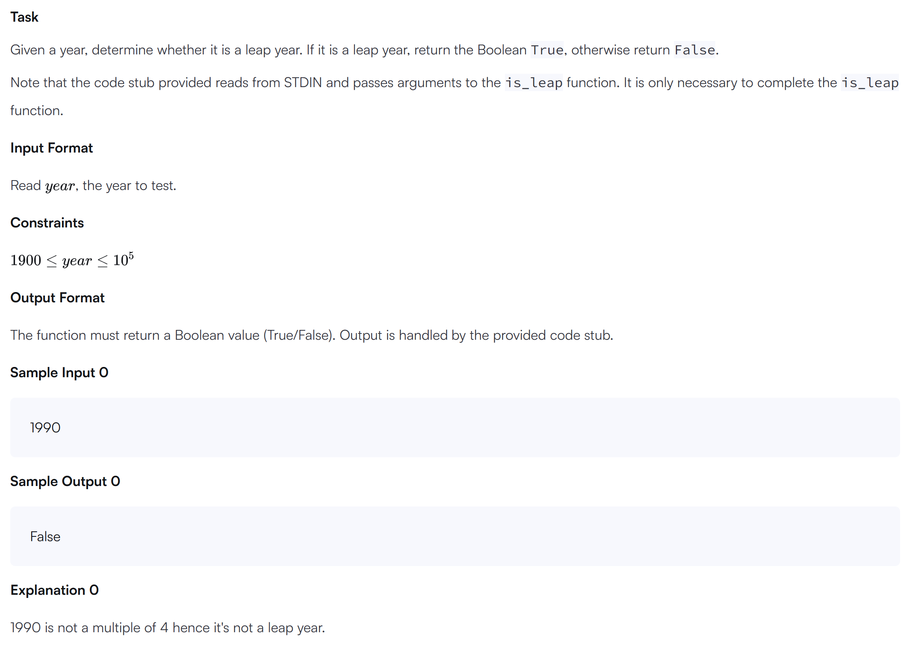
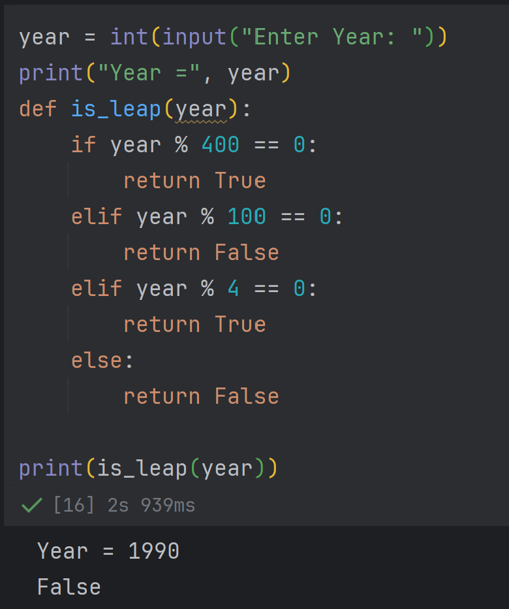
Part 2

